Slide 1
Electric Arc Welding
SMAW
Submerged Arc Welding
Lecture 10

Slide 2
Introduction to Arc Welding
Processes fall under Arc Welding:
SMAW
GTAW
GMAW
Submerged Arc Welding
SMAW:
It is also known as Manual arc welding, it is simple portable and inexpensive, suitable for almost all kinds of materials, can be used in hard to assessible areas and has low initial cost.

Slide 3
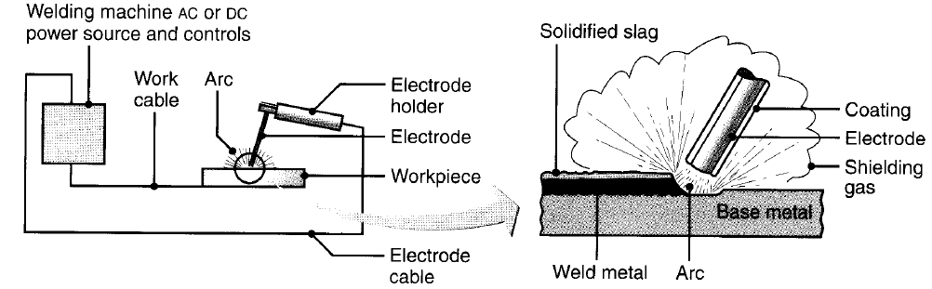
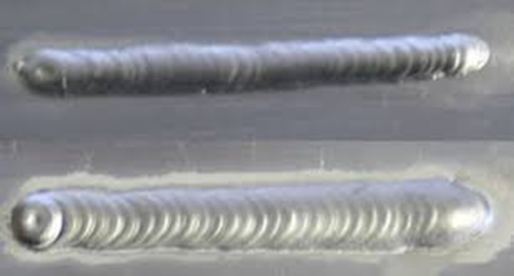
Introduction to Arc Welding
Arc welding equipment and process [3]
Weld bead

Slide 4
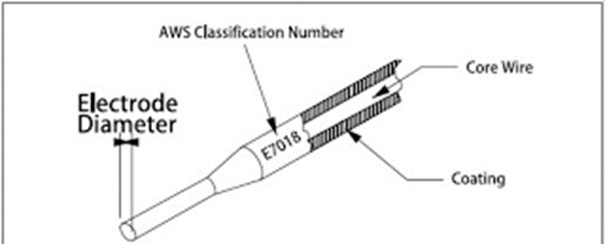
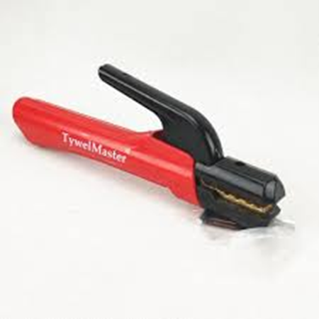
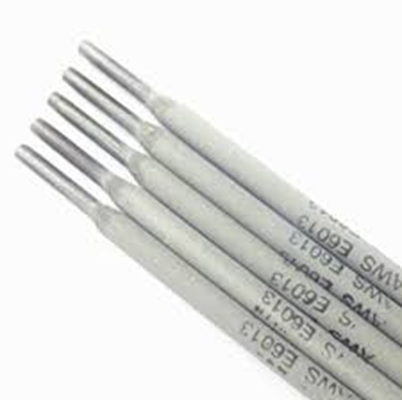
Arc Welding Equipment
Welding machine / transfer (AC)
Electrode holder
Cables
Chipping hammer
Wire brush
Flux coated electrode
Welding shields
Goggles
Gloves
Apron
1.Electrode Sketch
2. Electrode holder
3 Electrode.

Slide 5
Arc Welding Equipment
Both AC and DC are used for welding.
AC machines is a transformer which convert the supply to low voltage and high current. AC is recommended for ferrous metal.
For AC welding power is required at 80 to 110 volt and 50 to 300 ampere.
For DC welding normally power is required at 8 to 25 volts and 50 ampere.

Slide 6
Polarity in DC Welding
Straight Polarity:
Electrode is made negative pole and workpiece is made positive pole.
Two third of the total heat is generated at positive pole and only one third at negative pole.
Reversed Polarity:
Electrode is made positive pole and workpiece is made negative pole.
Polarity is decided according to the requirement of heat at either pole.

Slide 7
Arc Welding Electrode
Welding Electrodes:
Consumable electrodes and non-consumable electrodes.
Consumable electrodes provide filler metal.
Consumable electrodes are of two types i.e. coated and bare electrodes.
Bare electrodes are used in case of gas shielded welding.
Additional filler metal is required for non-consumable electrode (GTAW).

Slide 8
Coated Electrodes
Electrode is coated with flux.
The common ingredients act as flux which help in slag formation are asbestos, mica, silica, fluorspar, titanium dioxide, magnesium oxide, calcium oxide, manganese oxide, alumina, ferrous oxide, calcium fluoride and silicates of potassium & sodium.
Some of the above contents are used as per the required properties in the weld.
Ingredients used to produce reducing atmosphere are cellulose, dalomine, wood flour, starch. Iron powder provides higher deposition rate. Manganese oxide and potassium silicate and titanate are the alloying elements and stabilizers.

Slide 9
Merits of Flux on Electrodes
Develops reducing atmosphere and prevents oxidation.
Forms separable slag from metal impurities.
Establishes arc stability.
Improves bead appearance.
Avoid weld spatter.
Provides necessary alloying elements to the weld pool.

Slide 10
Types of Flux Coating
Cellulose coating:
Good penetration, CO and Hydrogen generate during process makes joint brittle.
Rutile coating:
More Titanium Dioxide as compared to first one.
Iron oxide coating:
Less gas produced, protection by slag.
Basic or low Hydrogen generating content coating:
Calcium carbonate and calcium fluoride produce CO + CO_{2,} short arc length is maintained for protection.

Slide 11
Other Welding Equipment
Connecting Cables Welding:
The cable used to connect electrode holder with power source it is flexible enough to facilitate easy movement of electrode. The cable is provided with good insulation coating and can bear high current.
Welding Shield:
Welding shield is used for the protection of eyes of the welder from ultraviolet radiations which may cause permanent damage to eyes.
Chipping Hammer:
Chipping hammer is also used to remove slag coating to clean the joint.

Slide 12
Arc Welding Control Parameters
Work angle
Travel angle
Arc length
Travel speed

Slide 13
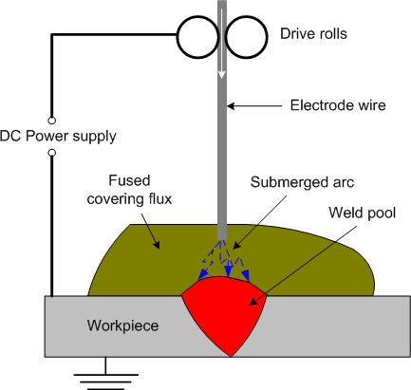
Submerged Arc Welding Equipment
Schematic diagram of Submerged Arc Welding [2]

Slide 14
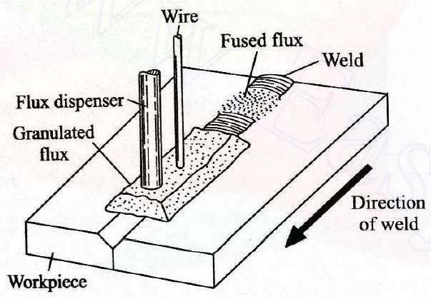
Submerged Arc Welding Process
Schematic diagram of Submerged Arc Welding [1]

Slide 15
Submerged Arc Welding
Flux contains Calcium Oxide, Calcium Fluoride and Silica sintered to form coarse powder.
Flux powder is spread on the joint to be weld.
Metal Electrode is fed into this flux.
Flux melts and cover the weld bead.
AC and DC is used with current rating 200 to 2000 amps.
Used to weld thick sheets.

Slide 16
References / Further Readings
[1] Ghosh, A. & Mallik, A.K.; Joining processes, Manufacturing Science, Latest edition.
[2] Lecture 19: https://drive.google.com/file/d/16o4wOavcwCZW9tFDZPvAkRmMzdt_NfeQ/view
[3] Kalpakjian, S & Schmid, S,; Manufacturing Processes for Engineering Materials, Latest edition.
[4] Lecture 14 & 15: https://nptel.ac.in/courses/112/107/112107089/

Slide 17


